Slide 1


Slide 3
WELCOME

Slide 4
Streamlining Research Management: Research Project Management Software

Slide 5
Addressing Key Needs

Slide 6
Addressing Key Needs
Manual processes can be cumbersome and time-consuming.

Slide 7

Addressing Key Needs
Manual processes can be cumbersome and time-consuming.

Slide 8
Addressing Key Needs
Manual processes can be cumbersome and time-consuming.
Lack of centralized system hinders project tracking and communication.

Slide 9
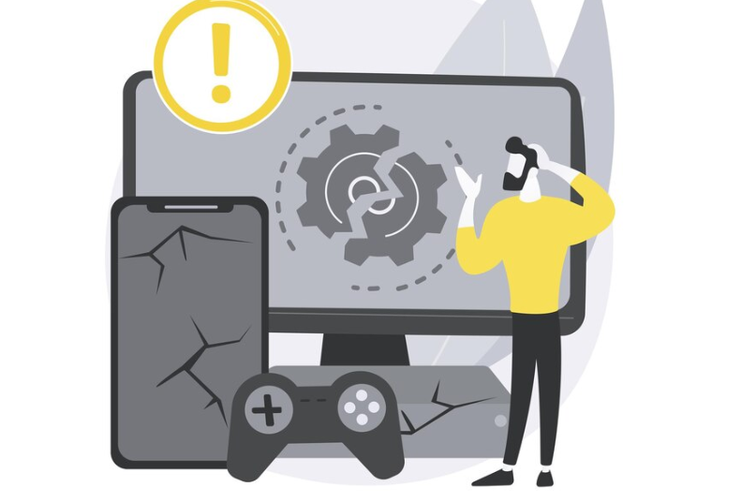
Addressing Key Needs
Manual processes can be cumbersome and time-consuming.
Lack of centralized system hinders project tracking and communication.

Slide 10
Addressing Key Needs
Manual processes can be cumbersome and time-consuming.
Lack of centralized system hinders project tracking and communication.
Our software offers a solution.

Slide 11
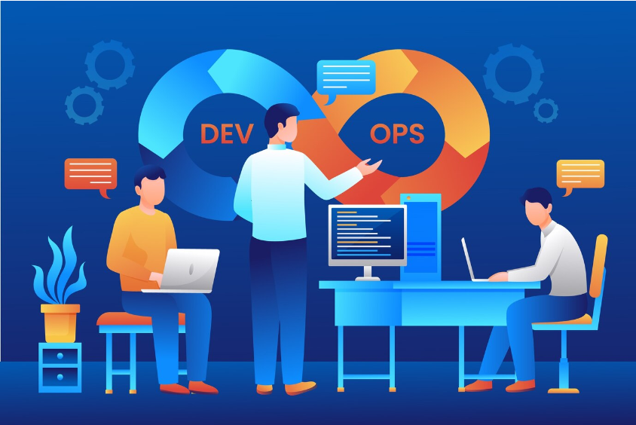
Addressing Key Needs
Manual processes can be cumbersome and time-consuming.
Lack of centralized system hinders project tracking and communication.
Our software offers a solution.

Slide 12
Enhanced Functionalities

Slide 13
Enhanced Functionalities
Manage research project information (from UGC).

Slide 14

Enhanced Functionalities
Manage research project information (from UGC).

Slide 15
Enhanced Functionalities
Manage research project information (from UGC).
Facilitate proposal submissions from researchers.

Slide 16

Enhanced Functionalities
Manage research project information (from UGC).
Facilitate proposal submissions from researchers.

Slide 17
Enhanced Functionalities
Manage research project information (from UGC).
Facilitate proposal submissions from researchers.
Optional reviewer assignment and evaluation process.

Slide 18

Enhanced Functionalities
Manage research project information (from UGC).
Facilitate proposal submissions from researchers.
Optional reviewer assignment and evaluation process.

Slide 19
Enhanced Functionalities
Project selection based on defined criteria (incorporating reviewer evaluations - optional).

Slide 20

Enhanced Functionalities
Project selection based on defined criteria (incorporating reviewer evaluations - optional).

Slide 21
Enhanced Functionalities
Project selection based on defined criteria (incorporating reviewer evaluations - optional).
Generate and send notification emails to researchers.

Slide 22

Enhanced Functionalities
Project selection based on defined criteria (incorporating reviewer evaluations - optional).
Generate and send notification emails to researchers.

Slide 23
Enhanced Functionalities
Project selection based on defined criteria (incorporating reviewer evaluations - optional).
Generate and send notification emails to researchers.
Announcement updates to notification channels.

Slide 24
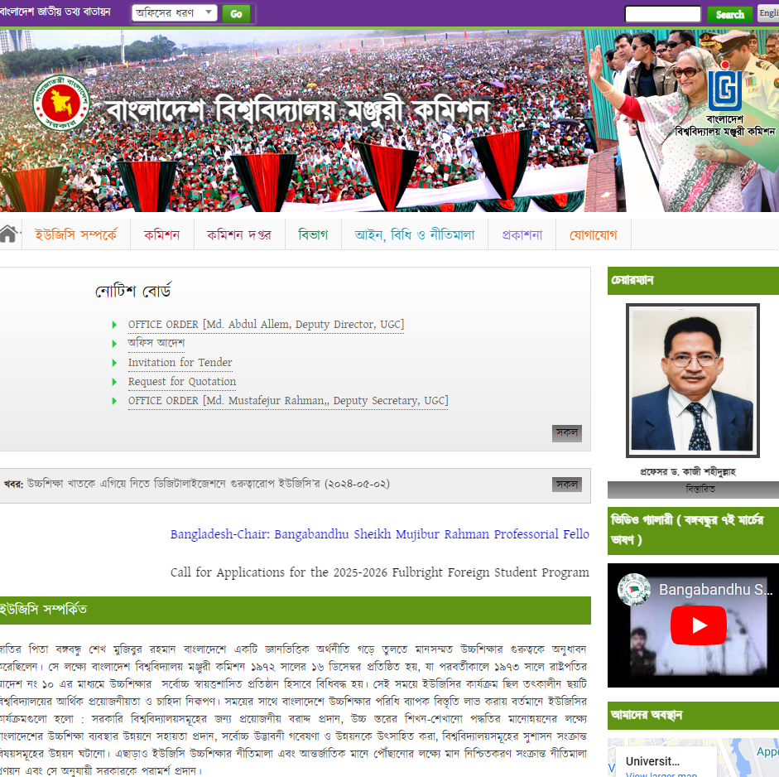
Enhanced Functionalities
Project selection based on defined criteria (incorporating reviewer evaluations - optional).
Generate and send notification emails to researchers.
Announcement updates to notification channels.

Slide 25

Enhanced Functionalities
Project selection based on defined criteria (incorporating reviewer evaluations - optional).
Generate and send notification emails to researchers.
Announcement updates to notification channels.

Slide 26
User-Centric Design

Slide 27
User-Centric Design
User-friendly interface for researchers and (optional) reviewers.

Slide 28

User-Centric Design
User-friendly interface for researchers and (optional) reviewers.

Slide 29
User-Centric Design
User-friendly interface for researchers and (optional) reviewers.
Secure data storage for proposals, evaluations, and project information.

Slide 30

User-Centric Design
User-friendly interface for researchers and (optional) reviewers.
Secure data storage for proposals, evaluations, and project information.

Slide 31
User-Centric Design
User-friendly interface for researchers and (optional) reviewers.
Secure data storage for proposals, evaluations, and project information.
Scalability to accommodate a growing user base and proposal volume.

Slide 32

User-Centric Design
User-friendly interface for researchers and (optional) reviewers.
Secure data storage for proposals, evaluations, and project information.
Scalability to accommodate a growing user base and proposal volume.

Slide 33
System Design – Data Flow Diagram (DFD)

